Slide 1
Library Protocol Discussion
Rob David – Staff Field Applications Specialist

Slide 2

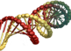
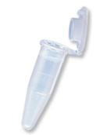
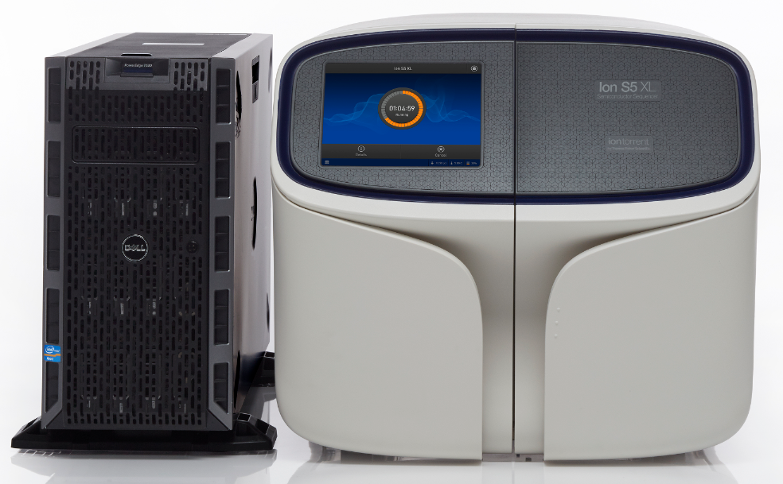
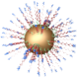
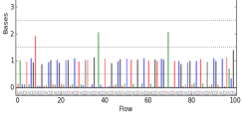

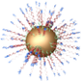
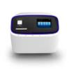
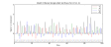
Ion Workflow Overview
A
DNA
B
Compatible Library Prep
C
10
Template Prep
10
Prepare
Library
Clonal
Amplification
Isolate Positive
Ion Sphere™
Particles
Load Chip
and Sequence
D
Data Analysis
Sequencing
E
Compatible Data
Notes:
Ion Torrent Systems, Inc.
2

Slide 3
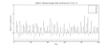
Ion Workflow – Library Prep
A
DNA
Fragment
Library
“Standard” PCR amplicons
(may need to fragment)
B
Compatible Library Prep
Amplicon
Library
Ion AmpliSeq™ DNA technology
Exome, Custom, or “Ready to use”
C
Fusion primers
Template Prep
Ion AmpliSeq™ RNA
RNA
Library
Small RNA library
D
Transcriptome library
Sequencing
E
Compatible Data
Notes:
Highlights: the reduction in workflow (50% less hands on) with physical shearing and introduction of supported amplicon protocol. Investigating other shearing methods to further reduce time. Updates coming later this year.
3

Slide 4
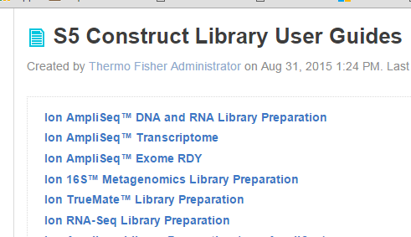
Ion Library Protocols
https://ioncommunity.thermofisher.com/docs/DOC-9697
Notes:
4

Slide 5
Fragment Library Construction

Slide 6
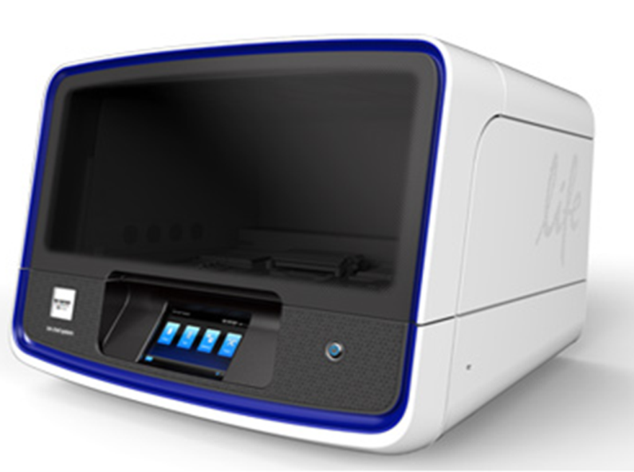
Library Prep: Fragment Workflow for gDNA
P
P
P
P
P
P
P
Shear
DNA
Blunt End
Repair
(for mechanical
shearing only)
P
End Polished Fragments
50-100 ng
or 1 ug DNA
Fragmented DNA
Adapter Ligation,
nick translation
& Size Selection
Template
Preparation
PCR Amplify
(if needed)
Optional: Normalization with Ion Library Equalizer™ Kit
Adapter Ligated Library
Amplified, Adapter Ligated Library
Notes:
6
The April 2011 updates included changes to the Library Prep protocol. We now have A/P1 adapter functionality (instead of A/B with old kits), and we now have dsDNA library output. Quant is with High Sensitivity DNA chip.
6

Slide 7
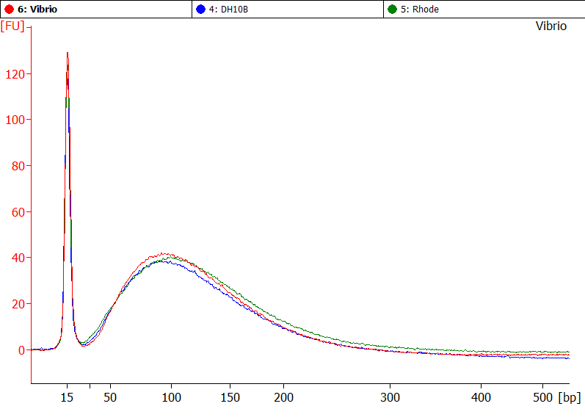
Ion Fragment Library Fragmentation Options
Two methods for Fragmentation
Enzymatic fragmentation:
Fragmented DNA is ready for adapter ligation (end-repair not needed).
Ultrasonic fragmentation:
Fragmented DNA is end-repaired and purified to prepare for ligation to Ion adapters.
Shear
DNA
50-100 ng
or 1 ug DNA
Fragmented DNA
38 % GC
65% GC
Different sequencing read lengths require different sizes of library inserts
Shorter library insert size require more (enzymatic) incubation times
Check fragment size after shearing, using Bioanalyzer® (optimal sensitivity) or E-Gel® system

Slide 8
Ion Fragment Library
P
Enzymatic shearing creates blunt ends,
so end repair of DNA sheared enzymatically is not needed.
P
P
P
End Repair
(physical shearing only)
P
Blunt End
Repair
P
P
Fragmented DNA
P
End Polished Fragments
P
Don’t freeze-thaw the 10x ligase buffer
Prepare single-use aliquots of 10x ligase buffer
Adapter Ligation
&
Nick Translation
P
P
P
P
P
P
Adapter ligation,
nick translation
P
End Polished
Fragments
(Broad size distribution)

Slide 9
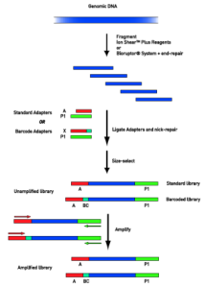
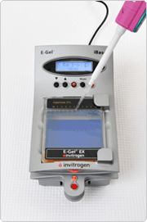
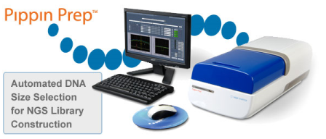
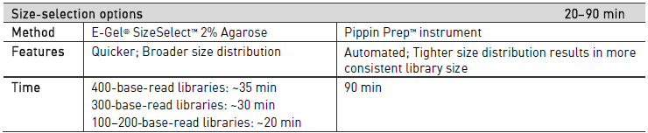
Ion Fragment Library Size Selection Options
Alternative method: Manual gel size selection method is available:
Notes:
9

Slide 10
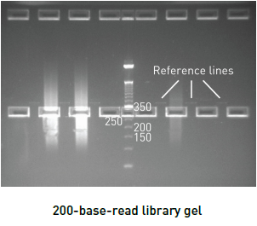
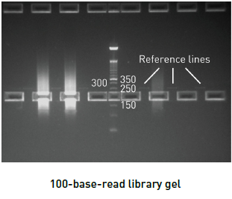
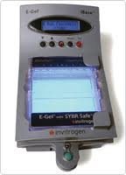
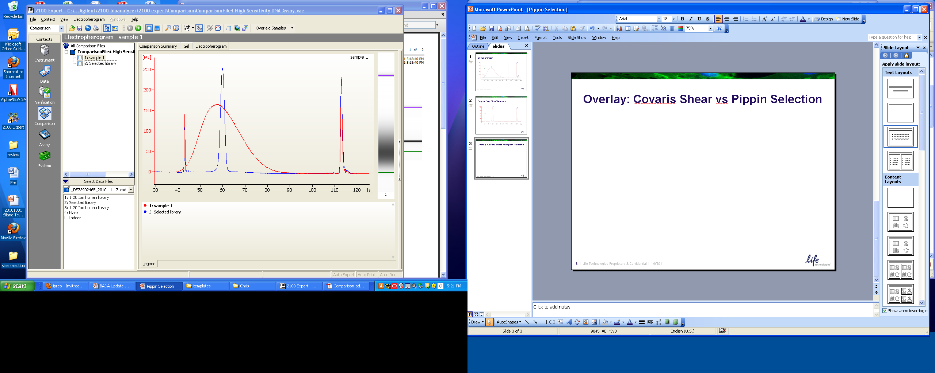
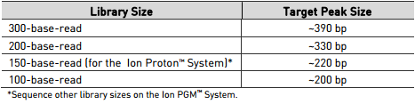
Ion Fragment Library Size Selection: E-Gel® SizeSelect™ Gels
___
___
Fragment Shear
Size Selected Sample
Size selection is necessary for maximization of sequencing yield
Notes:
10

Slide 11
Ion Fragment Library Amplification (if needed)
Advantage
Generates sufficient library amount from limited initial input
Increases efficiency of library: higher representation of productive fragments (with both A & P1 adaptors)
Disadvantage
May introduce bias (control by limiting cycle #)
Much higher cycle numbers can result in concatemers, etc.
PCR
Amplify
Template
Preparation
How many cycles should I use to amplify my library?
Number of cycles by library input
DNA | 50-100 ng | 1 ug
Cycles | 8 | 5
Amplification conditions can vary by application, see appropriate User Guides or User Bulletins.

Slide 12
Select Targeted Sequencing Methods

Slide 13

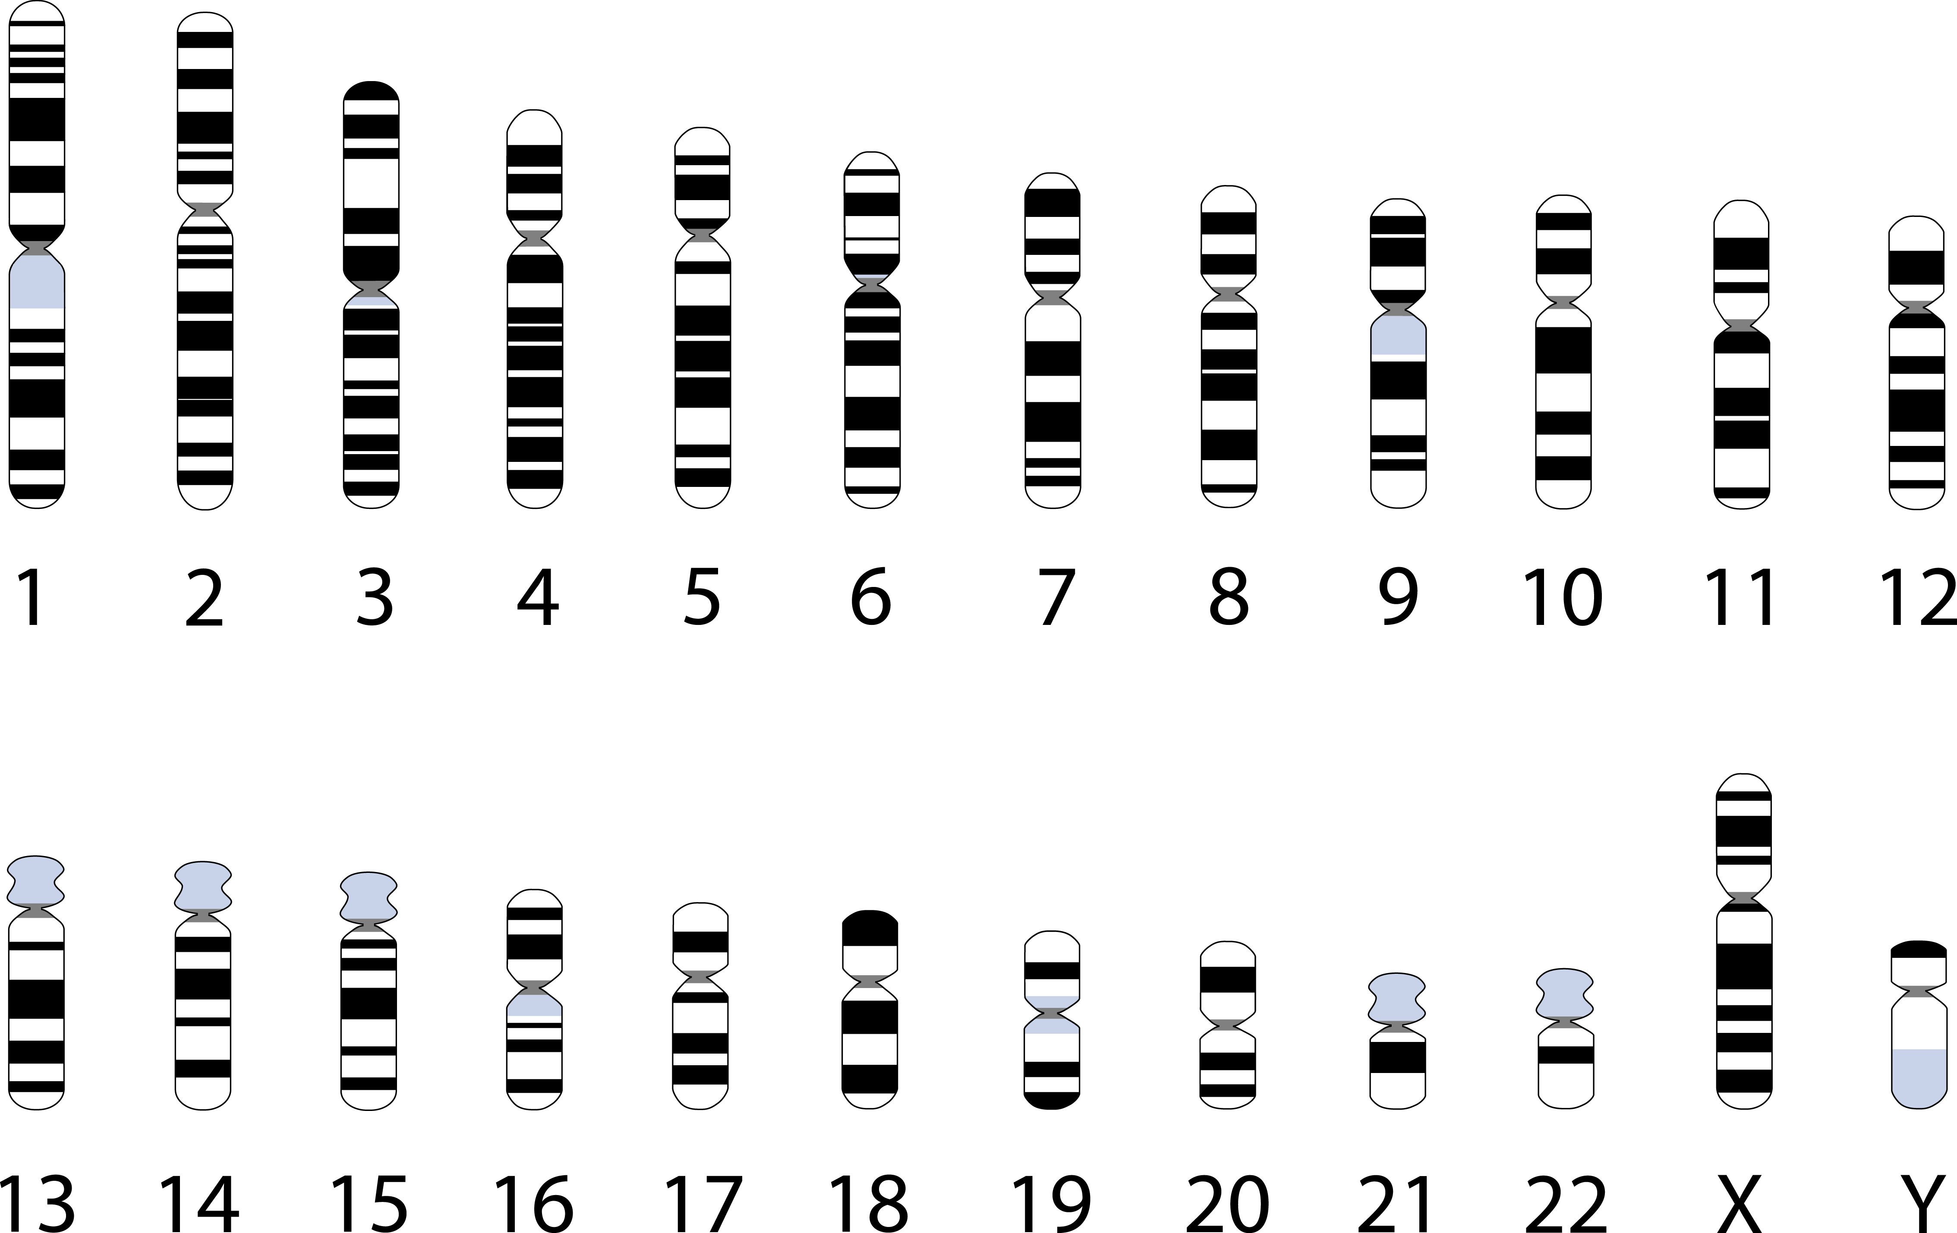

What is Targeted Sequencing?
Targeted Sequencing isolates and focuses your sequencing on specific genomic regions of interest rather than surveying the whole genome
Notes:
Targeted resequencing can be utilized for efficient interrogation of specific genes or genomic regions. Current target selection methods are lengthy, and complex, and usually require large amounts of input DNA. Truly effective translational research depends on the development of rapid approaches that deliver reliable results from small amounts of sample material and from challenging research samples such as
formalin-fixed, paraffin-embedded (FFPE) tissues. Ion AmpliSeq™ target selection technology introduces a groundbreaking workflow that
overcomes most known barriers to multiplex PCR, enabling the rapid sequencing of hundreds of known mutations for low-frequency allele detection or germline mutation detection. The single-tube workflow is as simple as setting up a PCR reaction and can be performed by any member of the lab. Superior coverage to detect low-frequency mutations, and automated analysis tools with Torrent Suite Software or Ion Reporter™ Software, enable you to go from extracted DNA to variant calls for relevant gene regions in just one day. Ion AmpliSeq™ target selection technology offers researchers the convenience of fixed-content panels and the power to create custom-content panels for use with Ion
PGM™ and Ion Proton™ Systems. Our ready-to-use panels include the Ion AmpliSeq™ Cancer Panel, the Ion AmpliSeq™ Comprehensive Cancer Panel, and the Ion AmpliSeq™ Inherited Disease Panel. For ultimate flexibility, Ion AmpliSeq™ Designer web-based software enables scientists to upload gene lists and create custom panels.

Slide 14
Why Do It?
Focus on regions of the genome that are important for your research
Low cost per sample
Fast: Ion AmpliSeq™ custom and ready-to-order panels offer the simplest and fastest workflow for targeted sequencing applications
Low Input: As little as 10 ng input DNA – FFPE ready; 500 pg unfixed RNA (5 ng FFPE), 1 ng input for HID kits.
Flexible: Using fixed and custom via Ion AmpliSeq™ Designer, you can focus on your content of interest.
Complete Analysis: Integrated variant calling and annotation via Torrent Suite™ and Ion Reporter™ software

Slide 15
ChipSeq

Slide 16
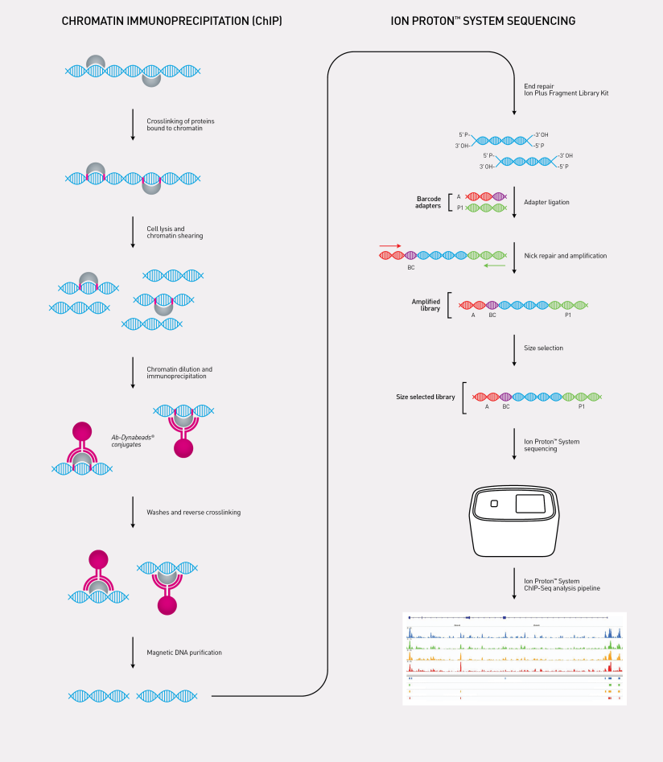
ChIP-Seq
Crosslinking of proteins bound to chromatin
Cell lysis and chromatin shearing
Chromatin dilution and immunoprecipitation
Ab-Dynabeads® conjugates
Washes and reverse crosslinking
Magnetic DNA purification

Slide 17
Amplicon libraries

Slide 18
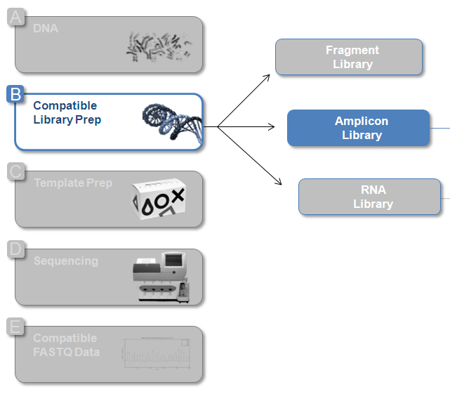

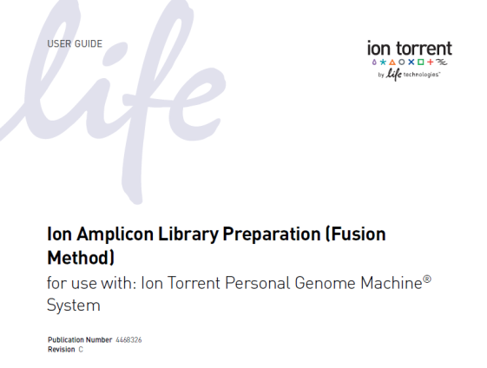
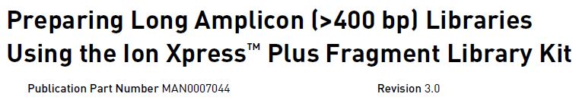
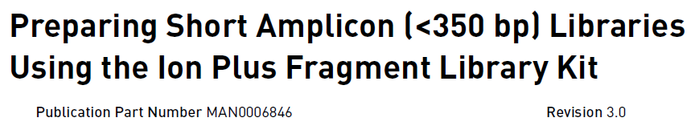
Amplicon Library Prep Methods
Ion AmpliSeq™ Technology
Rapid preparation of high-quality amplicon libraries from
single-tube, ultra-high multiplex PCR of gDNA & RNA
Ready-to-Use Panels
Custom Panels: Design content
with Ion AmpliSeq™ Designer
Fusion primers
“Standard” PCR amplicons (may need to fragment)
NOTE: No Ion Library Kit is needed for Fusion Method.
Notes:
18

Slide 19
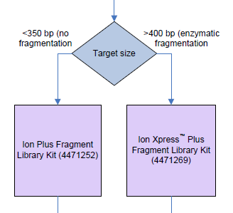
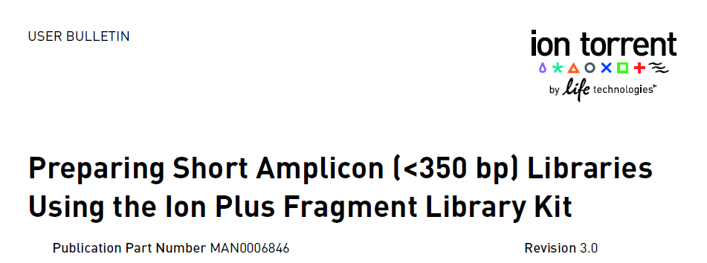
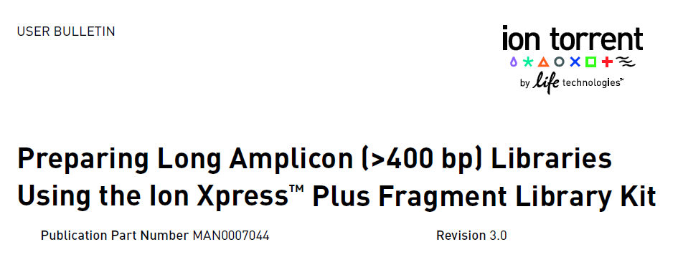
DNA Amplicon Libraries: “Standard” DNA Amplicons

Slide 20
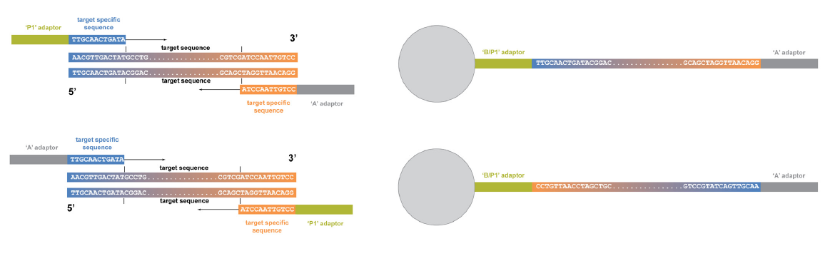
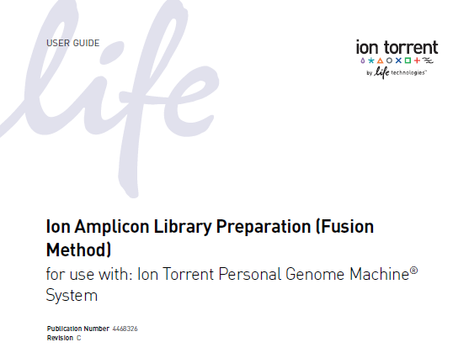
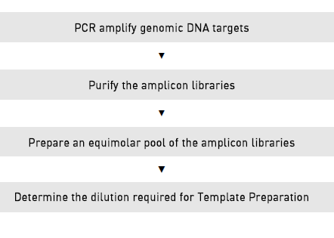
DNA Amplicon Library: Fusion Method
NOTE: No Ion Library Kit is needed for Fusion Method.

Slide 21
Targeted Sequencing with AmpliseqTM

Slide 22
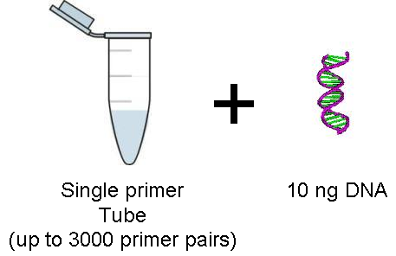
Ampliseq: So How Does it Work?
Ampliseq Panels
(up to 6000 primer pairs)
Intron
Exon
Multiplex PCR Ion AmpliSeq™ Primer Pool
Ampliseq
Library Kit
Partially digest primer sequences
A
Adapters
P1
OR
A-BC
Ligate adapters
Barcoded Adapters
P1
Optional
Nick-translate & amplify
Non-barcoded library
OR
Barcoded library
Notes:
The purpose of this slide is to show that every customer needs to order both the panels AND the library kit. The Ampliseq panels has the primers. The library kit has the reagents to digest the primers and attach the adapters. There is an Ampliseq DNA library kit and an Ampliseq RNA library kit. The orange are the ampliseq primers, the blue is the amplicons.

Slide 23
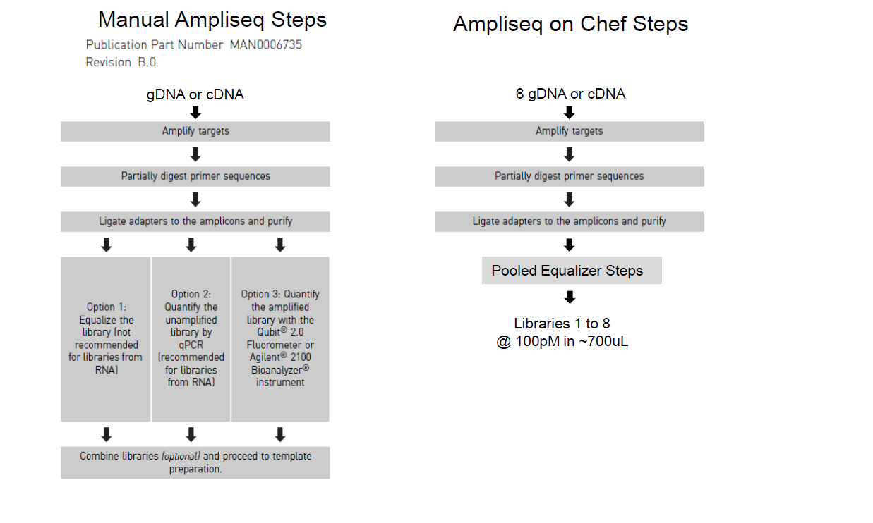
High Level Workflow Comparison

Slide 24

Variety of Research Applications
Mendelian Disease Research - Germ Line Mutation Detection
Cancer Research - Somatic Mutation Detection
Copy Number Variation/Aneuploidy
Genotyping by Sequencing
Quantitative Gene Expression
Fusion Transcript Detection
Biomarker Discovery
Notes:
Mendelian Disease Research - Germ Line Mutation Detection
Cancer Research - Somatic Mutation Detection
Copy Number Variation/Aneuploidy
Genotyping by Sequencing
Quantitative Gene Expression
Fusion Transcript Detection
Biomarker Discovery

Slide 25
Ion AmpliSeq™ technology
Ultra-high multiplex PCR for targeted sequencing and expression
Panels for DNA mutation, CNV analysis and RNA expression measurement
Up to 6,144 plex per tube using just 10 ng DNA or 5 ng RNA
Design and verification with leading researchers
Ready-to-use panels | Custom design | Community panels

Slide 26






Complete workflow for targeted resequencing
Select/ Customize targets
Construct library
Prepare template
Run sequence
Analyze data
Sample to results in a single day
Ion AmpliSeq™ Designer
Ion AmpliSeq™ DNA Library Kit
Or
Ion AmpliSeq™ RNA Library Kit
Ion Chef™ System
Torrent Suite™ Software
Ion S5 Sequencer
Ion AmpliSeq™ Panels
Ion OneTouch™ 2 System
Ion Reporter™ Software

Slide 27
Ion AmpliSeq™ Ready to Order Panel Menu
Exome RDY Panel Kit
Cancer Hotspot Panel v2
Comprehensive Cancer
Panel
Inherited Disease Panel
HID – Ancestry Panel
Dementia Research Gene Panel
AML
Research Panel
Cardio
Research Panel*
TP53
Research Panel
HID – Identity Panel
Hearing Loss Research Panel
BRCA 1 & 2
Research Panel
Colon & Lung Cancer Panel
CFTR
Research Panel
Primary Immune Deficiency Panel
Transcriptome Human Gene Research Panel
RNA Apoptosis Research Panel
RNA Lung Fusion Research Panel
RNA Cancer
Research Panel
* Coming soon

Slide 28
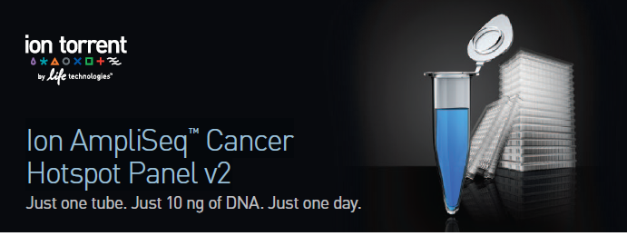
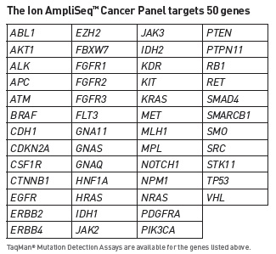
Ion AmpliSeq™ Cancer Hotspot Panel v2
>10ng input
50 genes
207 amplicons
*Gene list available www.lifetechnologies.com/ampliseqready
Notes:
- Gene coverage = at least 1 mutation covered for that gene
- Locus coverage = Unique start & end for that locus covered within the insert (between primers) 604 loci in the data set
- Mutation coverage = There can be >1 COSMIC mutation per Locus (different base change => different COSMIC ID)

Slide 29

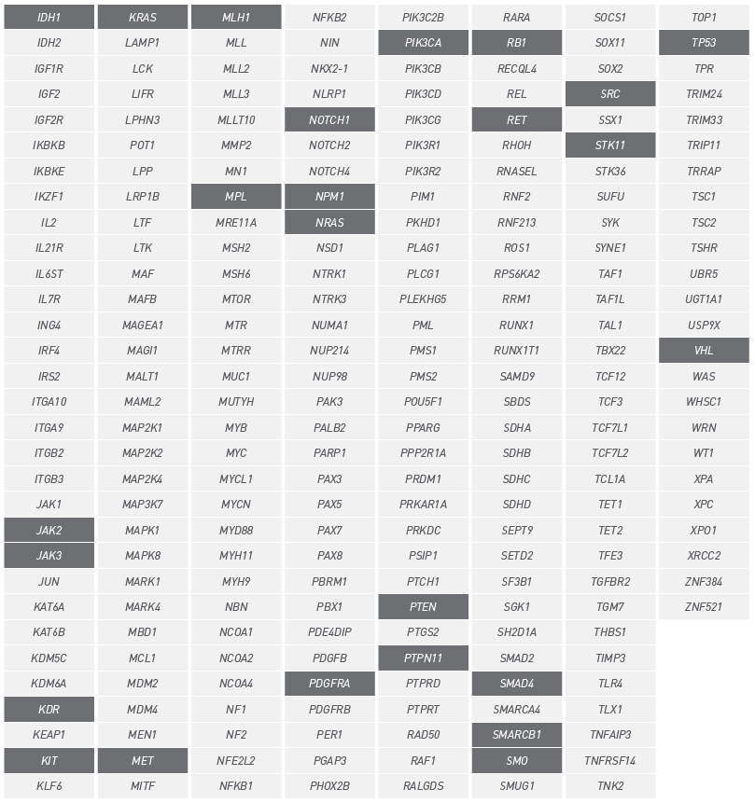
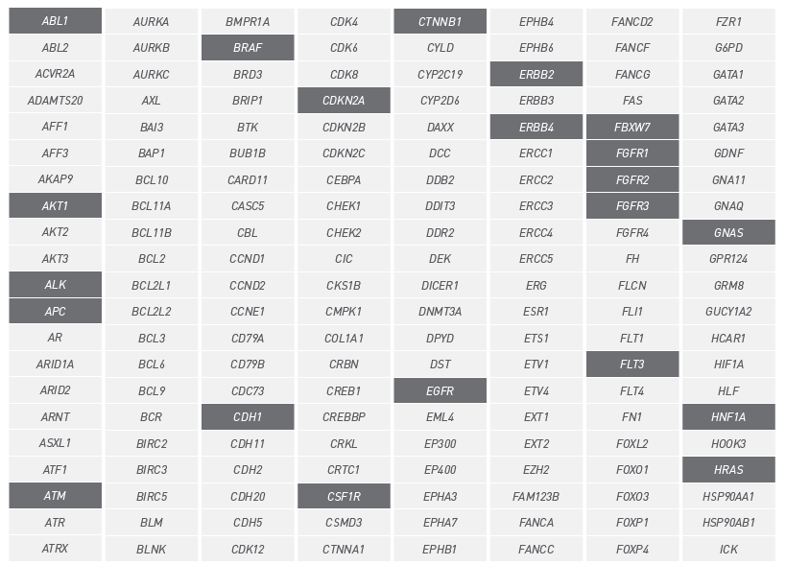
Ion AmpliSeq™ Comprehensive Cancer Panel (CCP)
Targets coding exons in 409 human oncogenes and tumor suppressor genes
~16,000 amplicons
Detection of known COSMIC somatic mutations
*Gene list available www.lifetechnologies.com/ampliseqready
For Research Use Only. Not for use in diagnostic procedures.
Notes:
In 4 pools
Recommend 30X coverage for ampliseq.

Slide 30

Ion AmpliSeq™ Exome
~294,000 primer pairs across 12 primer pools
>24,500-plex PCR!
~2.4 M PCRs per plate of 8 exomes!!
Total DNA input as low as 50 ng
Covers >97% of CCDS (Release 12)
>19,000 coding genes, >198,000 coding exons, no UTRs, miRNAs, or ncRNAs
Amplicon size range 225-275 bp
Average insert size is ~202 bp
Ion AmpliSeq™ Exome Kits include Ion PI™ Chips v2
Notes:
1-Choi M, Scholl UI, Ji W, Liu T, Tikhonova IR, Zumbo P, Nayir A, Bakkaloğlu A, Ozen S, Sanjad S, Nelson-Williams C, Farhi A, Mane S, Lifton RP (10 November 2009). "Genetic diagnosis by whole exome capture and massively parallel DNA sequencing". Proc Natl Acad Sci U S A 106 (45): 19096–19101. Bibcode:2009PNAS..10619096C. doi:10.1073/pnas.0910672106. PMC 2768590. PMID 19861545.

Slide 31

Ion AmpliSeq™ Transcriptome Solution
Rapid, cost-effective gene-level expression analysis with simple workflows compatible with FFPE samples
Survey precious or degraded samples with as little as 10 ng input RNA
Gene-level expression surveys in less than 1 hour hands-on time (library prep), enabling RNA to gene expression levels in less than 2 days
Better depth of performance than arrays with wider dynamic range and detection of more genes at lower expression levels
Differential expression analysis with simple automated workflows that leverage existing microarray or NGS analysis pipelines
Notes:
Gene level
10 ng
U133 2.0 better dynamic range and sensitivity to low expressed transcripts

Slide 32
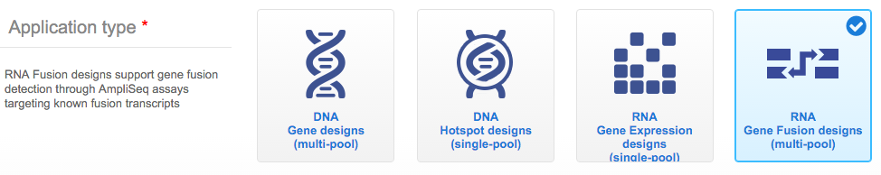
Ion AmpliSeq Custom RNA Fusion Panel
www.AmpliSeq.com
Detects fusion genes by targeting RNA fusion transcripts
Customize through Ampliseq.com selecting from over 1000 fusions
Compatible with as little as 1ng of FFPE RNA
5’ Gene
3’ Gene

Slide 33
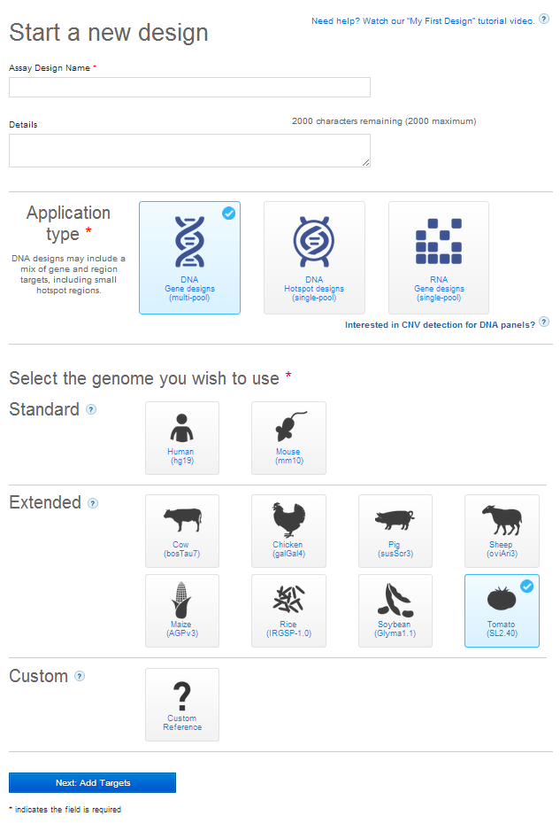

AmpliSeq Custom
Standard: Human and mouse
Annotations supported
Extended: Animal & Plant
Use of Coordinates
Animal: Cow, Chicken, Pig, Sheep, Dog, Chinese Hamster
Plant: Maize, Rice, Soybean, Tomato
Custom: Any reference upload
Load supported FASTA file
Use of coordinates

Slide 34
Ion AmpliSeq™ Designer
Online panel design in four easy steps at ampliseq.com
Ion AmpliSeq™
Designer
Ion AmpliSeq™
Custom Panel
Enter
targets
Submit
design
Review
design
results
Order
custom
panels
< 2.5 hours*
*2.5 hours based on 10 kb design. A 250 kb design can take up to 48 hours.
Notes:
Other than the ultra-low input, customers love AmpliSeq because it can be easily customized online via AmpliSeq designer.
The Ion AmpliSeq™ custom workflow starts with custom panel creation using Ion AmpliSeq™ Designer—a free, online assay design tool that connects you directly to our assay design pipeline. It's developed, optimized, and proven for human gene sequencing. All you need is a list of HUGO gene symbols or gene regions based on hg19 coordinates.
Custom panels are delivered in two formats: tubes of pre-pooled multiplexed primers in ready-to-use concentration and 384-well plates in which each well contains individual primer pairs in concentrated format. For custom panels with ≤96 primer pairs, you will receive 2,250 total reactions. For custom panels with >96 primer pairs, you will receive 9,000 total reactions.
Automated primer design in as little as 2.5 hours with minutes of hands-on time.
So this combination of low input and rapid, easy customization makes AmpliSeq better than TruSeq panels from Illumina or the GeneRead panels from Qiagen

Slide 35
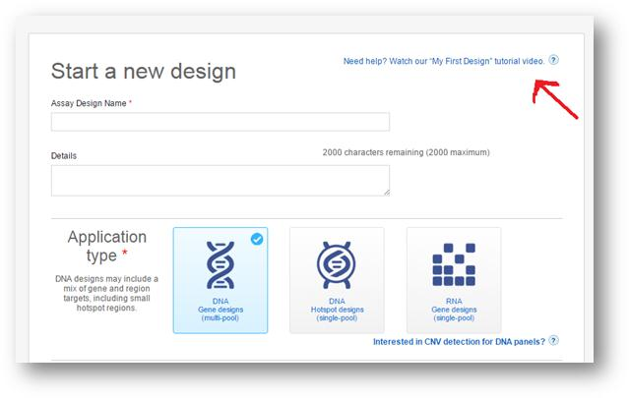
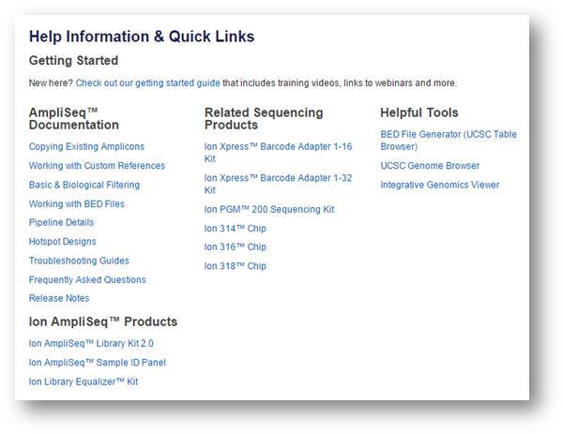
Ion AmpliSeq™ Designer
When you start a new design, then you can click on the video link:
Additional information can be found in the Help for more specific topics within Designer.

Slide 36
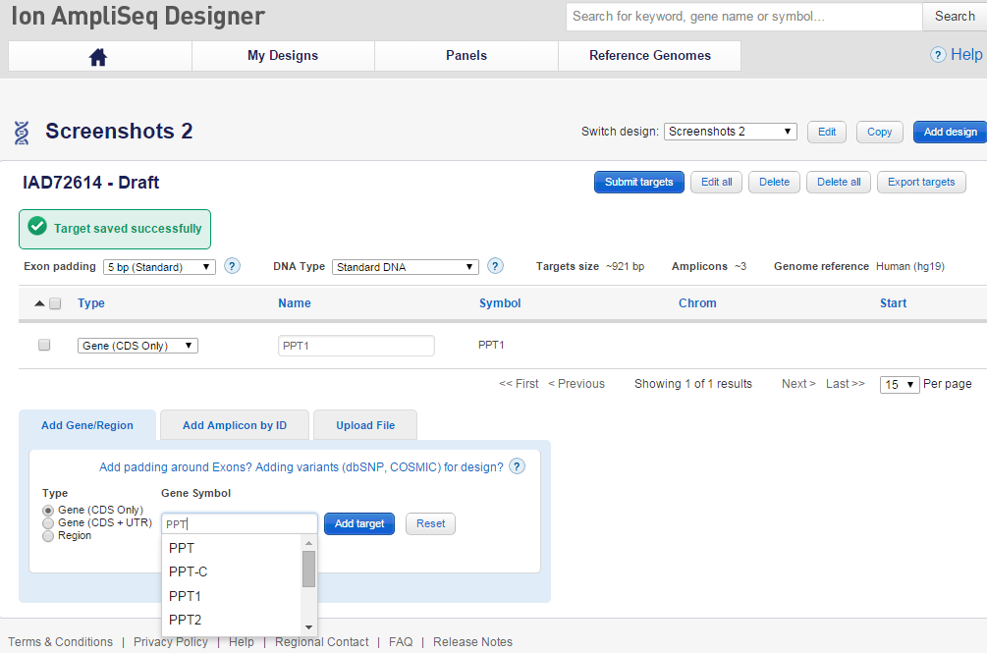
AmpliSeq Custom Panel
Start typing in the gene symbol and a list of potential genes to select from appears

Slide 37
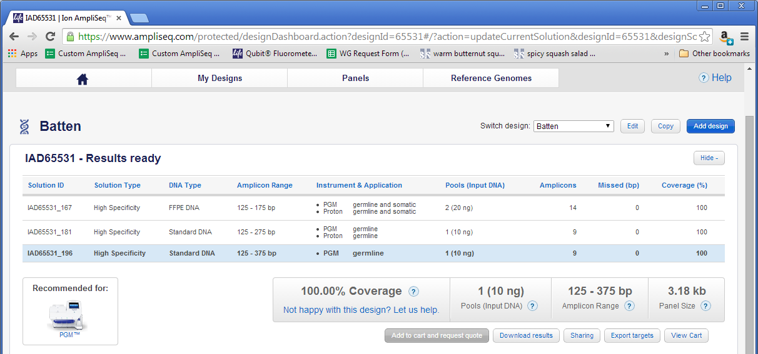
AmpliSeq Custom Panel
Notes:
This example took 25 minutes.

Slide 38
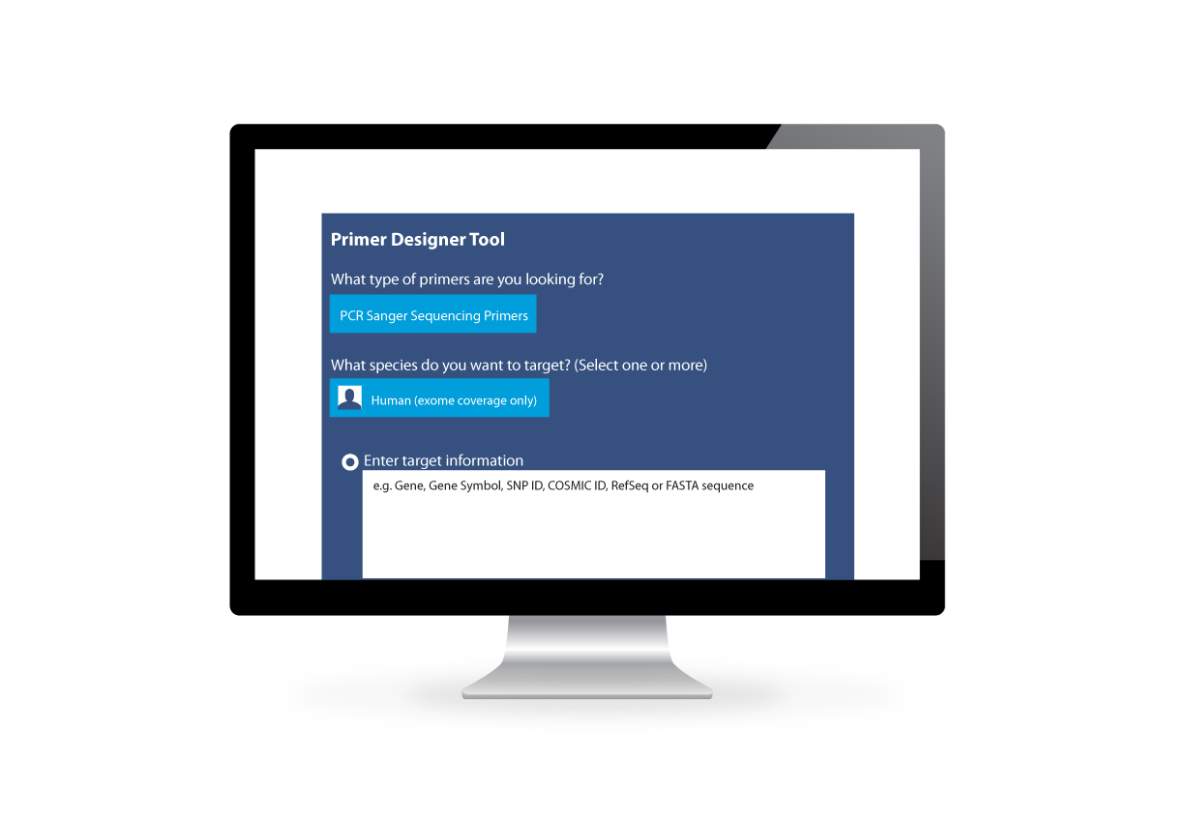
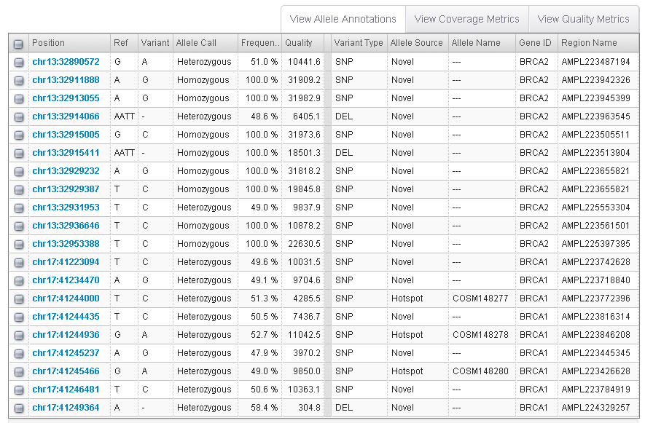
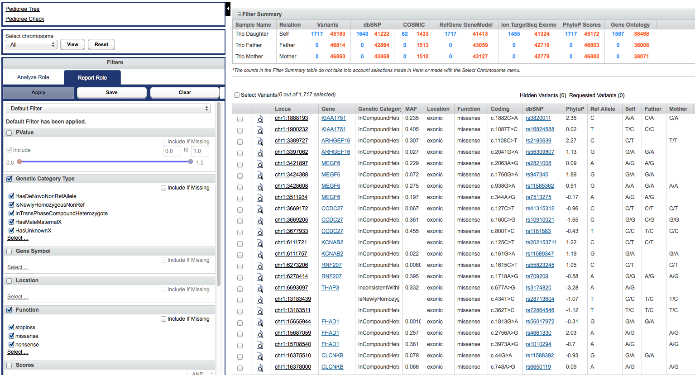
Software tools for easy analysis
Torrent Suite™ Software
Ion Reporter™ Software
Variants, Expression, Fusion Events
Biological relevance
Variant discovery in a few clicks
Notes:
And then there’s the final step of the sequencing workflow – the data analysis, which is usually perceived as the bottleneck. But with all the recent advancements in Bioinformatics, variant discovery can be completed in just a few clicks.
There are 2 main tools for analysis of the Ion Torrent sequencing data:
Torrent Suite Software can be used to plan, monitor and track your runs all within a web interface while reviewing the quality and accuracy of your sequencing run, in addition to variant calling, detecting SNPs and indels. This server comes with your Ion PGM™ System.
The additional layer of analysis for your data can be provided through Ion Reporter™ software. Sequence reads from the Ion PGM™ can beautomatically uploaded from Torrent Suite™ Software for analysis. In addition to alignment and variant calling, the Ion Reporter™ Software also annotates your called variants with information from both public and private databases. The Ion Reporter™ software can be accessed by all users on the cloud, free-of charge. Once the user exceeds storage of 100 GB, they will have to purchase the local server.

Slide 39
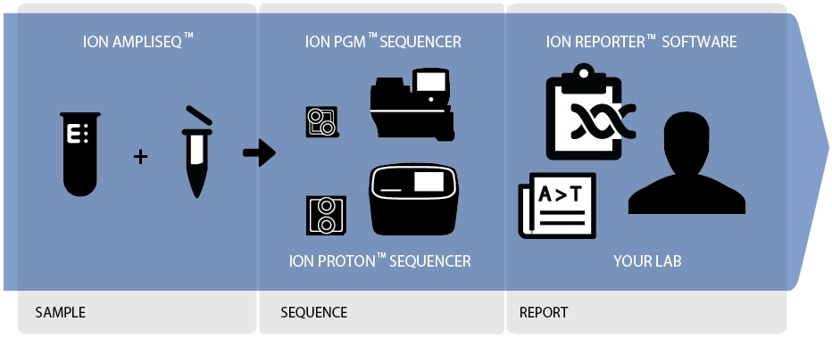
Ion Reporter™ Software
Simple push-button informatics enables any lab to do next-gen sequencing
Direct integration with the sequencer
Automated analysis from data generation to annotated variants & interpretation
Two solutions, local and cloud optimized to fit your needs
Automatically connects you with TaqMan® Assays and Primer Designs for Sanger Sequencing variant validation
Notes:
-IR bridges the gap between data generation and interpretation

Slide 40
RNA Sequencing: Ampliseq RNA, Ampliseq Transcriptome Ion Total RNAseq for WT & smRNA

Slide 41
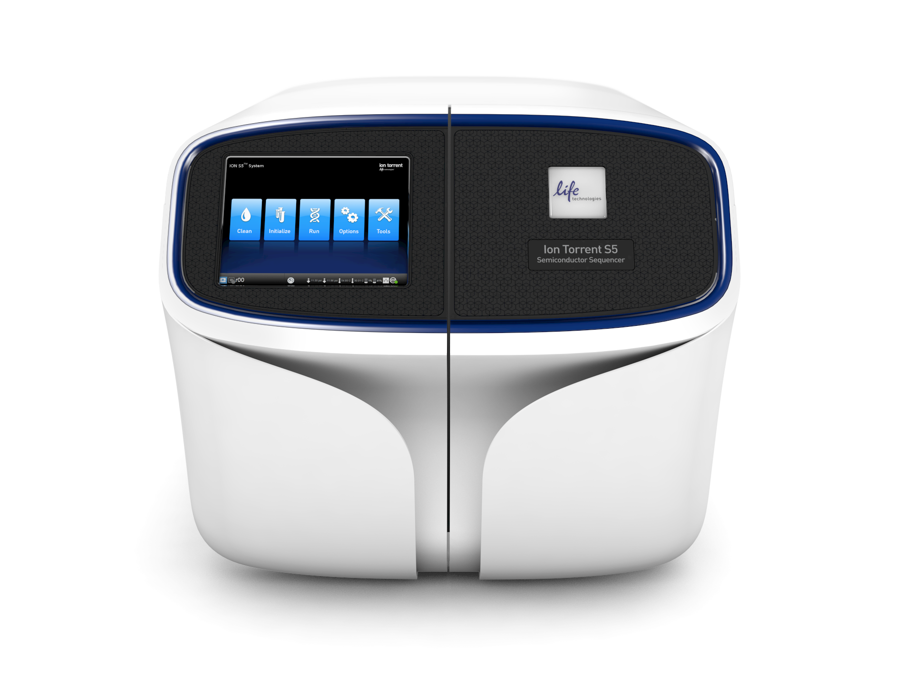
The Most Comprehensive Portfolio For RNA Applications
From single gene quantification to discovery
qPCR/
Digital PCR
Ion AmpliSeq™ Transcriptome
RNA-Seq
Expression levels for single gene targets
Differential gene expression & discovery of novel transcripts/ fusions & sensitivity for low-abundance RefSeq genes
Differential gene expression/profiling & sensitivity for low-abundance RefSeq genes
Panels for gene-level expression and fusion detection
Targeted Ion AmpliSeq™ RNA Panels
Number and breadth of expression targets surveyed

Slide 42
AmpliseqTM RNA

Slide 43
Ion AmpliSeq Technology – A single workflow for many applications
Ion AmpliSeq technology
Amplify
Digest
Ligate
Oncology
Research
Panels
Gene
Fusions
Copy Number
Variants
Inherited Disease Research Panels & Exomes
Txome
&
RNA Expression
Infectious
Disease
Research
Panels
RNA - The Ion AmpliSeq Advantage
Low Input – FFPE compatible, works with as little as 1ng input
High Sensitivity – targeted panels enable exclusion of unnecessary high expressers

Slide 44
AmpliseqTM Transcriptome

Slide 45




Ion AmpliSeq™ RNA Panels
Ion AmpliSeq™
RNA Libraries
Reverse
Transcript-
ion
Multiplex
PCR
Adapter
Ligation
Qualify &
Quantify
~5 hrs
Digest Primers
Purify
Amplification
RNA Cancer Research Panel
50 genes
Corresponds to genes in Ion AmpliSeq™ Cancer Hotspot v2
5 ng FFPE or 500 pg unfixed RNA
RNA Apoptosis Panel
267 genes
TaqManTM Assay
5 ng FFPE or 500 pg unfixed RNA
RNA Custom Panels
Over 20,000 human genes with thorough coverage of the coding genome
Single amplicon per gene
1 pool design
5 ng FFPE or 500 pg unfixed RNA
Custom RNA Fusions
1,000 fusion targets now available
Compatible with Human (RefSeq and Ensembl databases)
Research Use Only. Not for use in diagnostic procedures

Slide 46
Ion AmpliSeq™ Transcriptome Solution
Rapid, cost-effective gene-level expression analysis with simple workflows compatible with FFPE samples
Survey precious or degraded samples with as little as 10 ng input RNA
Gene-level expression surveys in less than 1 hour hands-on time (library prep), enabling RNA to gene expression levels in less than 2 days
Better depth of performance than arrays with wider dynamic range and detection of more genes at lower expression levels
Differential expression analysis with simple automated workflows that leverage existing microarray or NGS analysis pipelines
Notes:
Gene level
10 ng
U133 2.0 better dynamic range and sensitivity to low expressed transcripts

Slide 47
Ion AmpliSeq™ Transcriptome Solution - overview
Ion AmpliSeq™ Transcriptome Human Gene Expression Kit
Comprehensive coverage of RefSeq - 20,802 genes targeted
Single primer pool – simple workflow
FFPE-compatible as little as 10 ng RNA
Total RNA input from FFPE and other sources - no selection or enrichment
Assay design
One amplicon per gene
~150 bp amplicon size with ~110 bp insert size
Crosses exon boundary where possible
Simple Analysis
Torrent Suite™ application specific plugin for gene-level expression reports
Gene
Exon 1
Exon 2
Exon 3
Exon 4
Notes:
Doesn’t detect isoforms or splice variants.

Slide 48


Ion AmpliSeq™ Transciptome Human Gene Expression Library Workflow
Simple, rapid workflow
<1 hour hands on time
Low input RNA: 10 ng input
FFPE compatible
Represents over 20,000 human RefSeq genes
Wide dynamic range and improved detection sensitivity compared to conventional microarray analysis
Complementary software plug-in for automated sequencing analysis
Notes:
Automation options are available – see Appendix

Slide 49
FFPE vs Fresh Frozen – high correlation
No additional amplification or ribosomal depletion necessary starting with as little as 10ng of total RNA from FFPE samples
Data generated with 8 samples per PI v2 chip using 200 v3 chemistry on lung tumor samples
Affymetrix data from lung tumor samples
Pearson r correlation | Ion AmpliSeq™ Transcriptome | Affymetrix U133 plus 2.0 with Sensation Plus FFPE kit
FF vs. FFPE | 0.93 | 0.89
Proprietary and Confidential
Notes:
Good correlation between FPEE/frozen with ASTxome, better than affy FFPE kit (3x costly & labor intensive)

Slide 50

Wider dynamic range and more genes detected than arrays
8 samples per Ion PI chip
Proprietary and Confidential
Notes:
Good FFPE compatibility, now performance vs microarrays.
What’s in the sample. How many do I see, are expressed.
U133 MAQC ~9500 genes in UHR, 8 samples on PI (multiplex drives down price) w see another 6400 genes. (65% more gene detected) with multiplexing, with FFPE, with low input.

Slide 51

More differentially expressed genes than arrays
Ion AmpliSeq™
Transcriptome
Affymetrix® U133 Plus 2.0
(MAQC)
8 samples per Ion PI chip
Notes:
Largest app for microarrays.
RNA-Seq high sensitivity, few are looking for discovery of isoforms, fusions.
60% more diff expression genes/
FFPE challenging

Slide 52



Excellent correlation across orthogonal platforms
qPCR
RNA-Seq
Microarrays
Cor = 0.96
Cor = 0.94
Cor = 0.91
Proprietary and Confidential
Notes:
What makes you feel good.
Highest….Validate or correlate with qPCR.
Excellent, highest correlation with qPCR. With RNA-Seq too and microarrays good for comparison (S/N, dynamic range, cross hyb)This is with AST at 8 samples per PI chip and the RNA-Seq at 2 per PI chip. So – great performance with 4X less reads.

Slide 53
Ion S5 Ampliseq Transcriptome Workflow
Select targets
Construct library
Prepare template
Run sequence
Analyze data
Sample to results in less than 2 days
Ion AmpliSeq™ Transcriptome Human Gene Expression Panel
Ion AmpliSeq™ Library Kit Plus
Ion Xpress™ Barcode Adapters
Ion Chef™ System
Ion OneTouch™ 2 System
Ion S5™ Sequencer
Ion PI™ Chip Kit
Torrent Suite™ Software
Proprietary and Confidential
Notes:
Good performance and fast too in less than 2 days
New panel humna gene panel
AS lib kit and cDNA syn kit and BC
OT2 or Chef used for validation
-TSS ASTxome plug in performs Automated alignment and gene quantitation →Provides table with all genes and normalized quantitation for all barcodes/samples
4.2.1 Torrent Suite™ ampliSeqRNA plugin

Slide 54

Low Hands-on time for FFPE/challenging samples
1
6
5+
21+
11
37
Hours
*Values obtained from Affymetrix.com
** Values obtained from Illumina.com
Proprietary and Confidential
Notes:
Comparison:
Customers with FFPE primary target.
Ours 1 + 6
Affy >20 hrs
ILMN RNA Access RNA-Seq , 2 rounds exome capture almost 50 hrs, cheap to sequence but lots of hands prep and tougher on RNA-Seq bioinfx.

Slide 55

Rapid Workflow from Sample to Results
7
15+
27
18
48
18
Hours
*Values obtained from Affymetrix.com
** Values obtained from Illumina.com– does not include time to align/process reads through RNA-Seq bioinformatics pipeline
Proprietary and Confidential
Notes:
Stat to end.
Under 2 days on ion (OT2)
Microarrays: ushed over 40
Nextseq: long protocol + 18 2x75 run still 60hrs.
High performing. FFPE friendly. Total RNA, 10 ng, 2 days.

Slide 56

Torrent Suite™ Software - ampliSeqRNA plugin
Plugin supports basic analysis
Automated alignment and gene quantitation
Provides table with all genes and normalized quantitation for all barcodes/samples
Notes:
4.2.1 required.
AmpliSeq RNA run plan with new kit human GE kit panel and the plug in
How do I analysis? Align what is 2 step? what is top hat? Pay someone…
plug in takes care of it for you.
automatically aligns reads on per barcode basis, quantities to target gene
BC, # mapped reads…tables to output information raw quantitative and normalized

Slide 57


Easy quality control and analysis in Torrent Suite™ Software
Simple, plugin-based analysis
Familiar QC plots for array users
Basic differential expression comparison
Notes:
Also provides a scatter plot for replicates or differential expression.
Differentially expressed annotated gene lists.
For further statistical analysis….

Slide 58
Ion Total RNAseq

Slide 59

Ion Torrent™ Whole Transcriptome Sequencing
Rapid, high quality comprehensive transcriptome characterization
RNA-Seq enables smRNA & WT sequencing in a hypothesis-free manner
Better depth than arrays with wider dynamic range & more transcripts at lower expression levels
One click data export into downstream analysis software
Easy validation via TaqMan® qPCR assays

Slide 60




Ion Total RNA-Seq Kit v2
Hands-on Lab Course
Also available!
Create whole transcriptome (WT) or small RNA libraries
Preserves strand information
Adaptor and RT primer sequences for Proton™ sequencing, for inputs of 100 ng total RNA or 1 ng miRNA
Optimized Workflow – 5-6 hrs for small RNA and for WT libraries

Slide 61
Ion Total RNA-Seq Kit v2: How Does It Work?
Preparation of whole
Preparation of whole
transcriptome
transcriptome
RNA
RNA
Preparation of small RNA
Preparation of small RNA
From 100 ng total RNA
Obtain total RNA then determine the quality
Fragment the RNA
Enrich small RNA
Magnetic beads
Magnetic beads
Clean up the RNA
Quantitate
small RNA sample and determine input amount
SOLiD
PGM
™
™
amplified library construction
amplified library construction
Hybridize and ligate the RNA adapters
Perform reverse transcription
< 5 hours
< 6 hours
Magnetic beads
Magnetic beads
Purify the cDNA
Amplify the cDNA
(BC addition)
Magnetic beads
Magnetic beads
Purify the amplified DNA
Assess the yield and size distribution of the amplified DNA
IonSphere™ particle preparation and Ion PGM™sequencing
SOLiD
™
System templated bead preparation and sequencing
33
Confidential and Proprietary—DO NOT DUPLICATE

Slide 62


RNA-Seq is now the RNA Discovery Tool of Choice
For the same period, publications on gene expression microarrays grew at an annualized rate of 1%
Over the last five years – RNA-Seq publications grew at an annualized rate of 163%
PubMed searches for “RNA Seq”, “gene expression microarray
Notes:
Since the production phase of the ENCODE project, the pace of publications on gene expression microarrays grew only 1% on an annual basis, while RNA-Seq publications grew at an annual rate of 163 over the same period. This shift was accelerated by seminal publications highlighting the benefits of RNA-Seq vs microarrays as well as novel discoveries that were impossible to find on microarrays.

Slide 63

Key Advantages of RNA-Seq vs Gene Expression Microarrays
 | RNA-Seq | Microarray
a priori sequence knowledge required | No | Yes
Detection of novel events | Yes | No
Dynamic Range* | Very High | Low
Measurement | Direct | Indirect
* http://www.ncbi.nlm.nih.gov/pmc/articles/PMC2949280/
Notes:
Microarray technologies require the use of oligos targeting known sequence, unlike RNA-Seq, which is a hypothesis free approach capable of detecting novel transcripts.
The dynamic range of RNA-Seq is very high, owing to the digital nature of counting reads and the sizable difference in background signal (Due to cross-hybridization) vs microarrays.

Slide 64
RNA-Seq Sample Preparation Workflow
RNA Isolation
Enrichment
Library Construction
Poly A Selection
Total RNA:
PureLink® RNA Mini Kit
MagMax™-96 Total RNA Isolation Kit
TRIzol® Reagent
RNA from FFPE:
MagMax™ Total Nucleic Acid Isolation Kit
Recoverall Total Nucleic Acid Isolation Kit for FFPE
Dynabeads® mRNA DIRECT™ Micro Kit
(not recommended with FFPE RNA)
Ion Total RNA-Seq Kit v2
Ion Xpress™ RNA-Seq Barcode 1-16 Kit
Ribosomal Depletion
RiboMinus™ Eukaryote System v2
Low Input RiboMinus™ System v2
Small RNA
Magnetic Bead protocol within the Ion Total RNA Isolation Kit v2
Notes:
LIFE Technologies offer a whole product solution available in a range of kits that allow the user to perform RNA Isolation, enrichment and library construction for the three of the more common approaches: small RNA, ribosomal depletion and poly A sequencing.
What you see here are sufficient for a wide array of samples – we strongly encourage new users to utilize the solutions listed above when first starting their RNAseq projects.

Slide 65

Ion S5™ System RNA-Seq Workflow
*
* The content provided herein may relate to products that have not been officially released and is subject to change without notice.
Notes:
Sequencing RNA on the Ion Proton System is a whole product solution leveraging a range of RNA preparation kits including library construction, templating, sequencing and software optimized for Ion Torrent data, all while leveraging run times less than 4 hours.

Slide 66
Key Advantages of RNA-Seq on S5™ System
Flexible, scalable sample throughput
Process 1-8 samples per chip
Fastest time to results
Go from RNA to data in <24 hours
Affordable solutions
Achieve an affordable price per sample without having to batch samples
Simple analysis workflow
One click data export into Partek® Flow® Software
Leverage familiar microarray based analysis tools that are optimized for Ion Torrent™ data
Notes:
The Ion Proton System provides a number of advantages vs alternative technologies in the market:
Leverage flexible options to process samples in increments amenable to your lab
Move from total RNA to data in less than 24 hours inclusive of 4 hour sequencing run times
Process samples at a competitive price per sample without having to batch 100+ samples per run
Utilize simple software that seamlessly exports data from the Torrent Server, performs Ion Torrent optimized sequence alignment while leveraging common microarray analysis tools

Slide 67


High Correlation with Other Technologies
Inter-platform comparisons demonstrate the high sensitivity of Ion Total RNAseq
HBRR vs. UHRR fold change measurements from Ion Proton correlate well (R>0.92) with microarray and qPCR data from MAQC project
Genes with detectable expression in platforms were compared.
Includes 35 million mapped Ion Proton™ System RNA-Seq reads, (A) 9,127 microarray gene measurements, and (B) 950 TaqMan® gene assays
A) Proton vs. MAQC array
B) Proton vs. MAQC qPCR
Life Technologies application note – CO27662
Notes:
Differentially expressed genes (DEGs) between HBRR and UHRR samples were determined and inter-platform concordance was used to illustrate the sensitivity of Ion Proton™ transcriptome sequencing. By comparing DEGs, the relative gene expression of transcriptome sequencing on the Ion Proton™ System could be compared to microarrays and qPCR. For optimal detection of DEGs by transcriptome sequencing, the fold change between HBRR and UHRR were calculated at 35M mapped reads. For a gene to be considered significantly differentially expressed, the fold change between UHRR and HBRR samples was ≥2.
A total of 17,279 RefSeq genes were shared between the MAQC microarray and transcriptome sequencing datasets, of these, 9,127 showed detectable expression in both datasets. A scatterplot of fold change comparison demonstrates the datasets were strongly correlated with a Pearson correlation (R) of 0.92 between transcriptome count data and microarrays (Figure A). A fold change comparison of transcriptome data to qPCR data from the MAQC study (a set of 950 TaqMan® gene assays) are highly correlated with a correlation coefficient (R) of 0.94 (Figure B).

Slide 68





Ion S5™ System RNA-Seq Data Analysis Workflow
Summarize & QC in Torrent Suite™ Software & export to 3rd party software
A
Data Generated
on Ion S5™
Sequencer
B
Base Calls
on S5 Torrent
Server
C
Quality Assessment
On Torrent Server
ERCC plug-ins
D
End to end RNA-Seq data analysis provided by Partek® Flow® Software

Slide 69


Ion Torrent™ : Semiconductor Sequencing for Life™
Support
Robert David
6178723352
Robert.David@thermofisher
ionsupport@lifetech.com
Call 800-955-6288 in USA
Bioinformatic support
ngs-amsupport@lifetech.com
http://ioncommunity.iontorrent.com
The Chip is the Machine™
Notes:
PLEASE CHANGE TECH SUPPORT NUMBER TO MATCH YOUR REGION’S CONTACT INFORMATION – THIS IS US-ONLY

Slide 70

For Research Use Only. Not for use in diagnostic procedures.
Ion Torrent™ is a Thermo Fisher Scientific brand. © 2014 Thermo Fisher Scientific, Inc. All rights reserved. TaqMan is a registered trademark of Roche Molecular Systems, Inc., used under permission and license. All other trademarks are the property of Thermo Fisher Scientific and its subsidiaries.

